Slide 1
Classifying Music Genres: A Deep Dive into Sound Analysis

Slide 2

Overview
This project focuses on two main objectives, simultaneously exploring the intricate domain of music genre classification.
1. Employ transfer learning by using spectrograms for training the final layers of a preexistent classification model
2. Generate vector representations for musical compositions to reveal genre-based similarities among songs

Slide 3
Dataset
The GTZAN dataset was chosen for this project. Data Augmentation methods were explored.
10 genres to clasify
Blues
Classical
Country
Disco
Hiphop
Jazz
Metal
Pop
Reggae
Rock

Slide 4
Data augmentation methods & Results
Librosa library was used to extend the dataset size.
Gain variations
Semitone shifting
Noise addition
Tripled dataset size
Extended dataset usage results
Segmenting dataset
Split songs into multiple equal length parts
Vary data augmentation methods on all parts
Tackle data leakage across train/test/val splits
Results of data augmentation
Worse performance across all models, why?
Lost genre meaning across small segments
More advanced augmentation methods necessary
Bigger dataset needed e.g. MTG-Jamendo

Slide 5


Transfer learning
This part of the project consisted of creating the spectrograms, selecting a pretrained model and checking data augmentation appliance.
VGG 16
InceptionV3
Xception
Our own model
MobileNetV2
73% accuracy

Slide 6
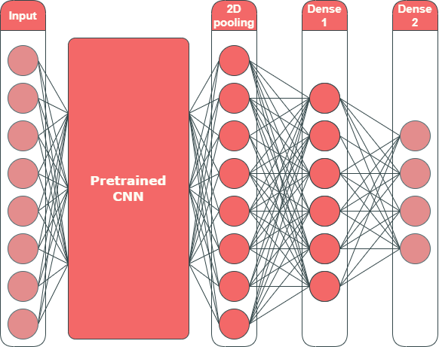
Musical vector representation
Apply dimensionality reduction (t-SNE) to embedding
Low level features
High dimensional
Sparse
High level features
Low dimensional
Dense

Slide 7
Appendix

Slide 8
Workload distribution
Per person
Anca: In charge of transfer learning and main model architecture design. Also looked for datasets
Rajiv: In charge of data augmentation, experimenting on various model architectures + adjusting architectures if needed. New data acquisition possibilities (looking for new datasets)
Óscar: In charge of the embedding layers in the network that would visualize our research. Created the demo and worked on implementing different dimensionaility reduction algorithms (e.g. t-SNE, PCA etc.)

Slide 9
Immediate
embedding
Shallow embedding
No
embedding
Deep embedding

Slide 10
